Slide 1
Movies and the Pandemic
Riley Capps
Erica Morales
Jose Davila
Mindy (Musch) Taylor

Slide 2
AGENDA
Riley’s Chart​s
Jose’s Charts
Erica’s Charts
Key Takeaways
​​​

Slide 3
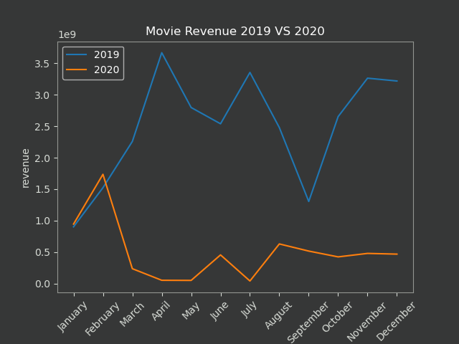

Slide 4
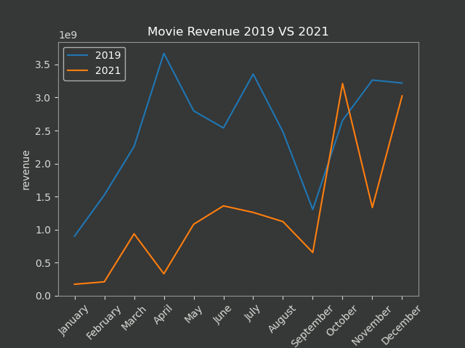

Slide 5
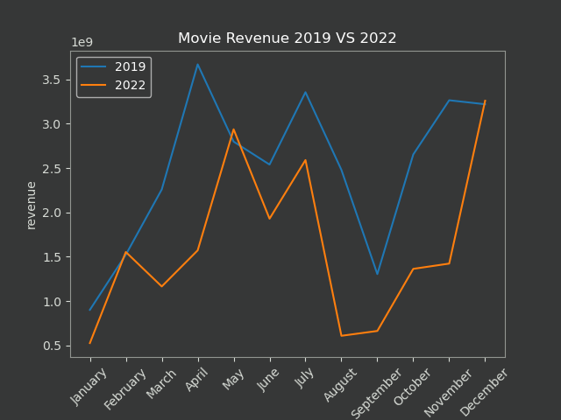

Slide 6
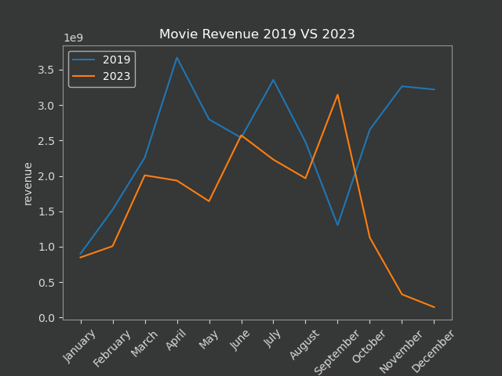

Slide 7
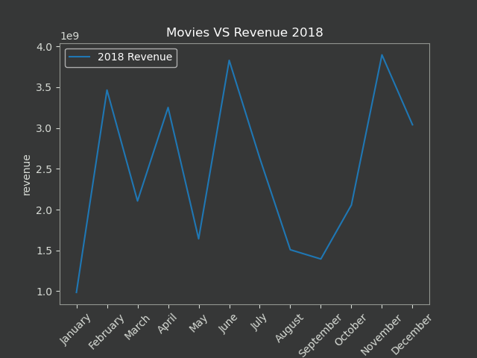

Slide 8
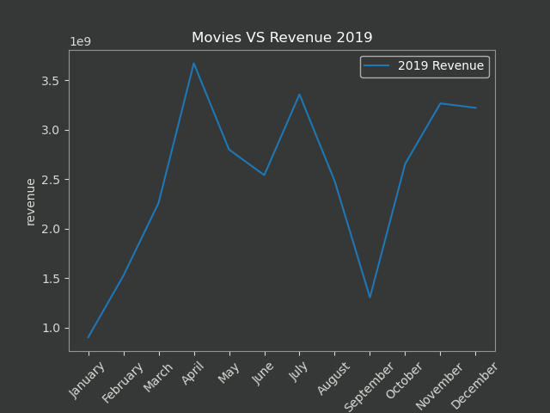

Slide 9
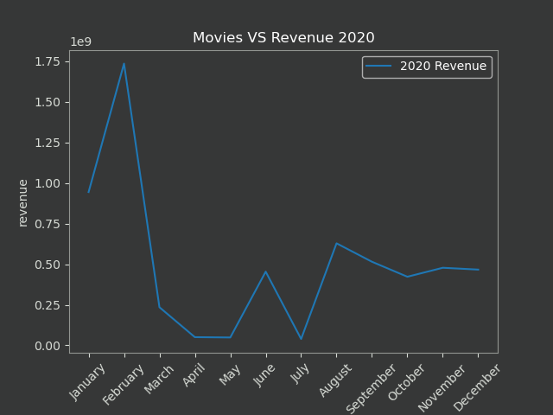

Slide 10
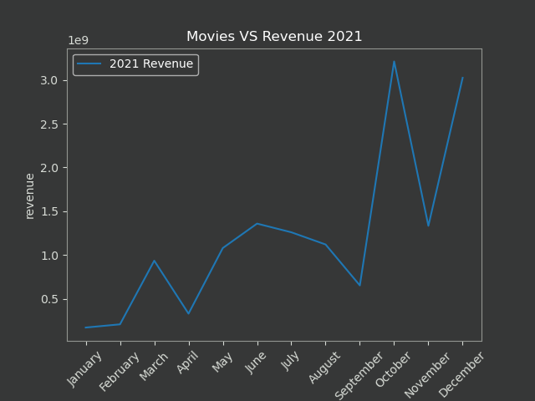

Slide 11
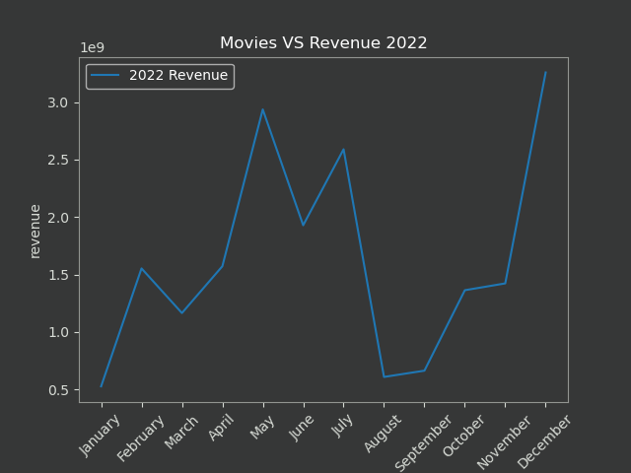

Slide 12
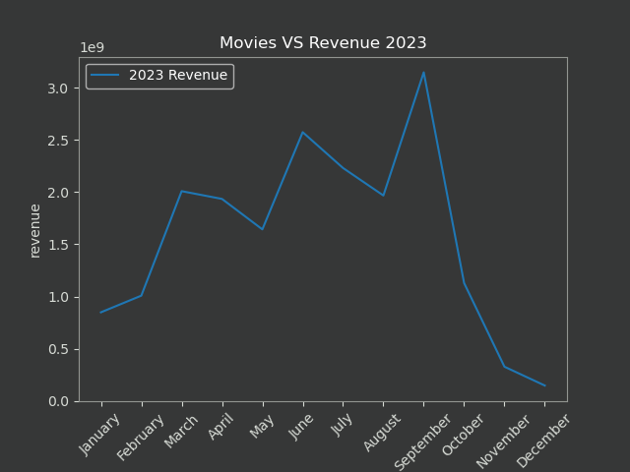

Slide 13
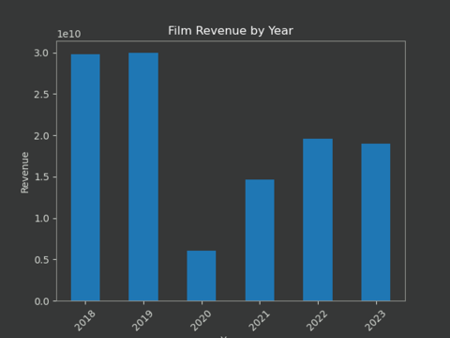

Slide 14
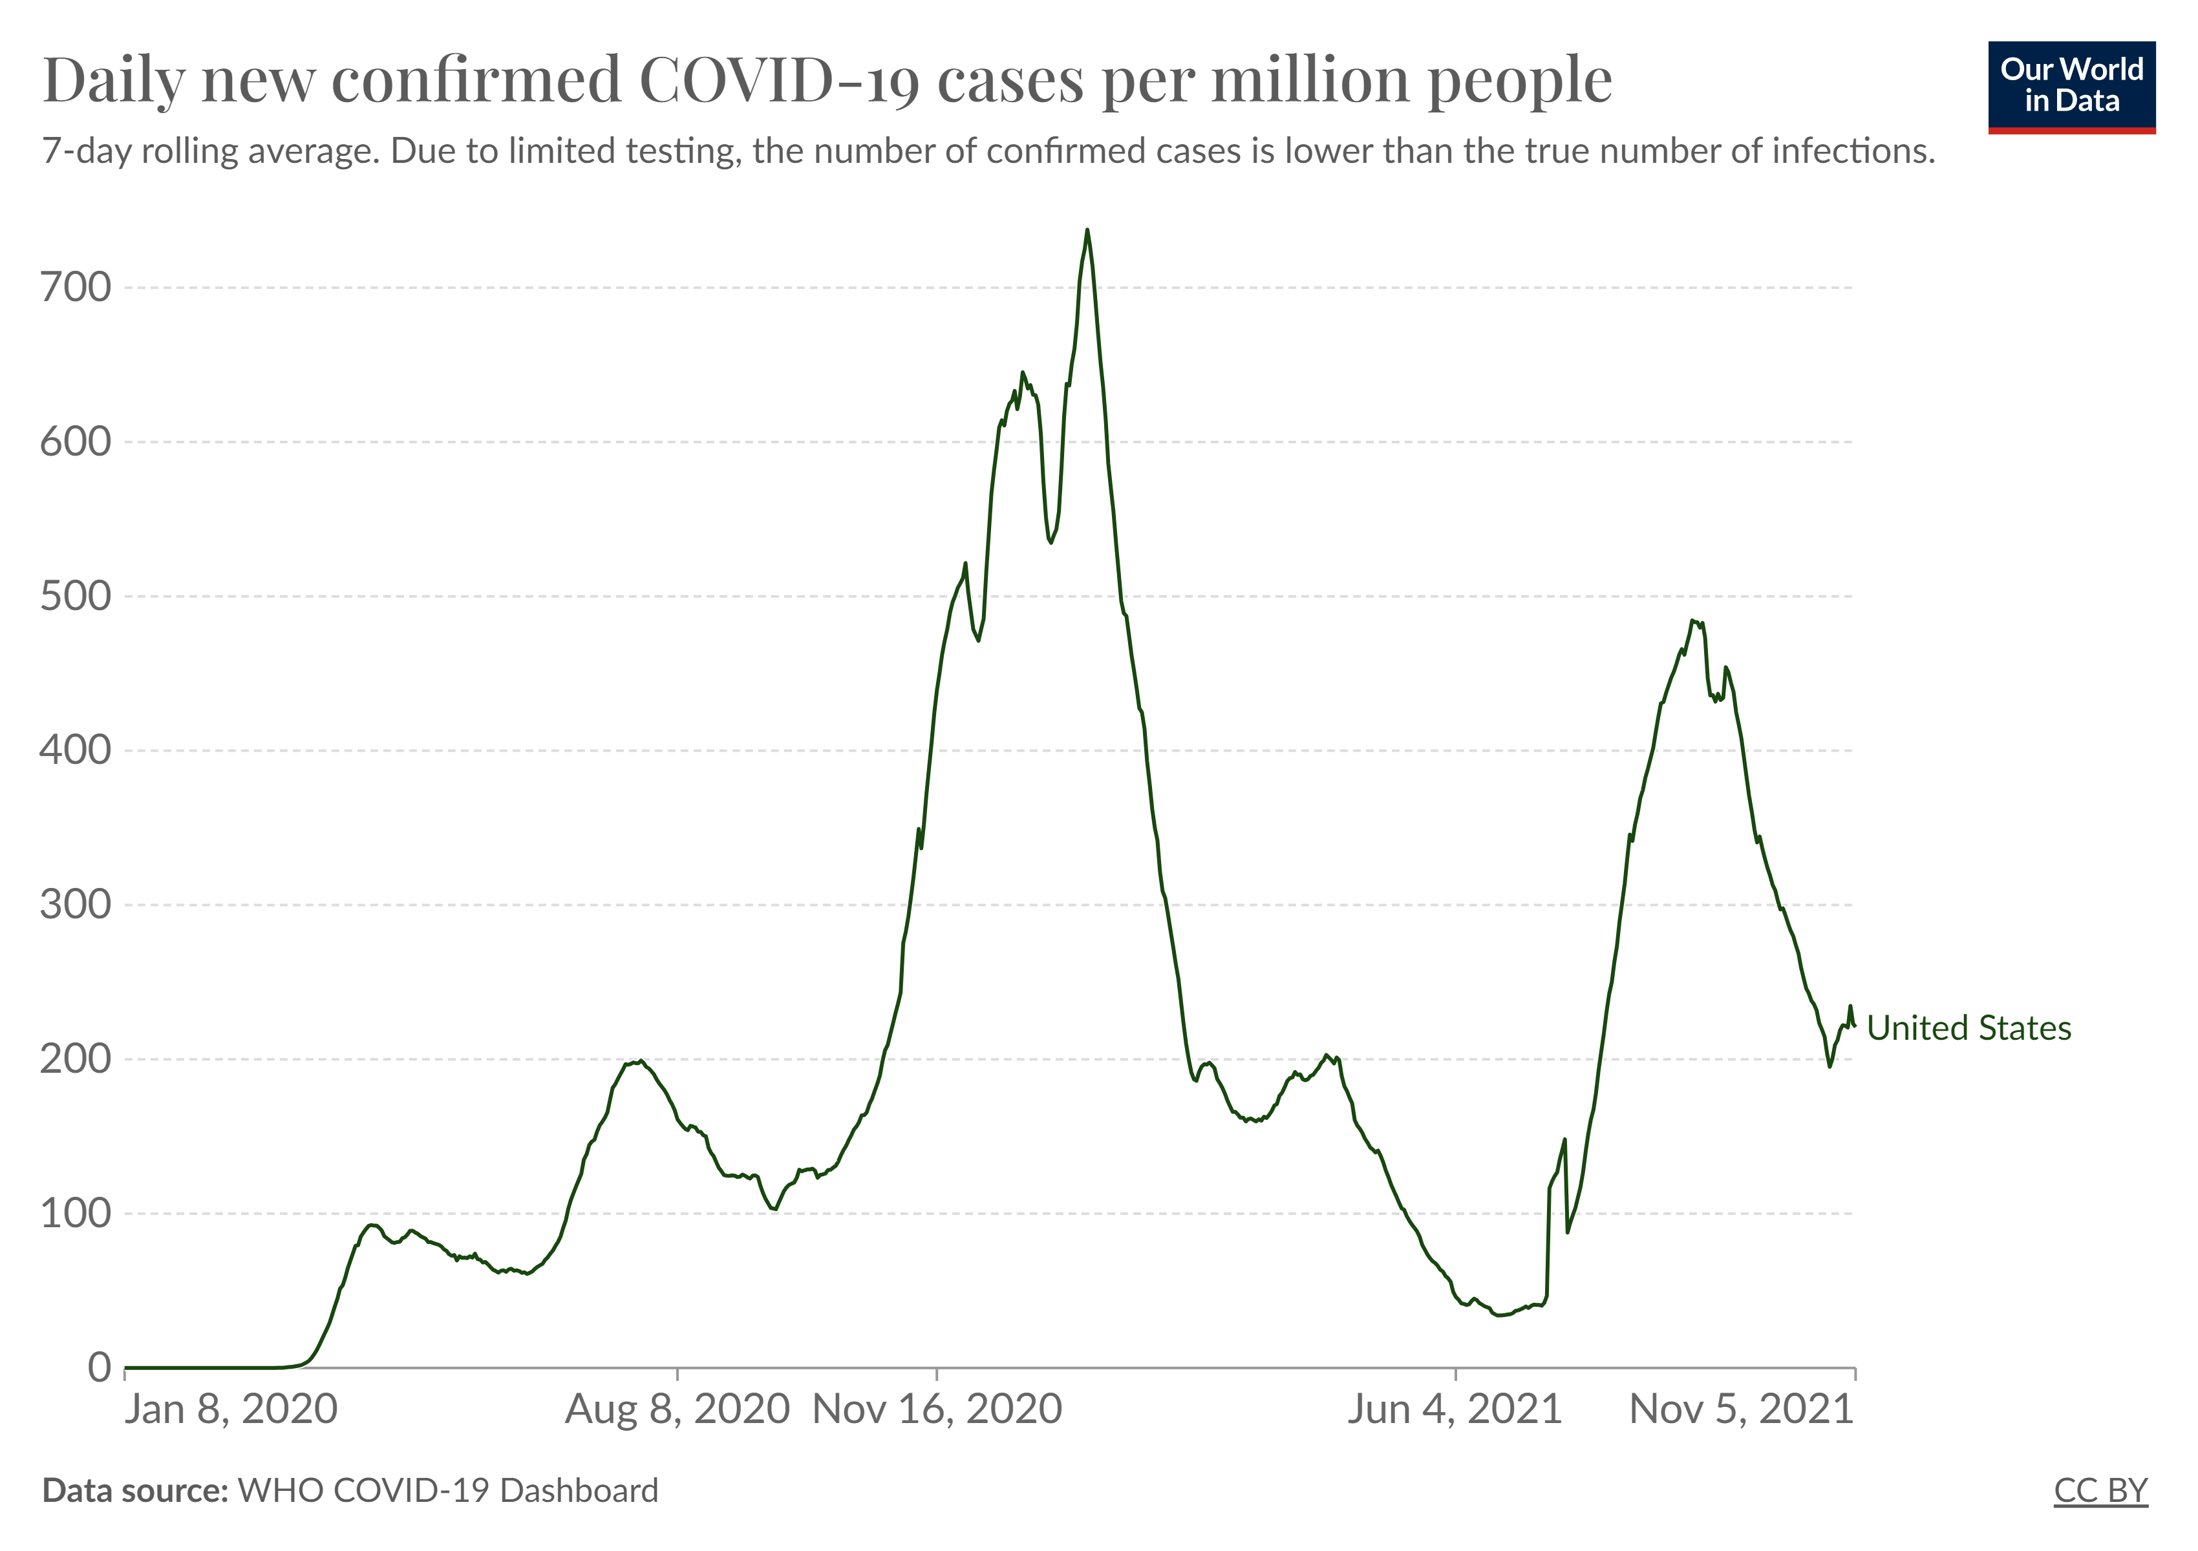


Slide 15
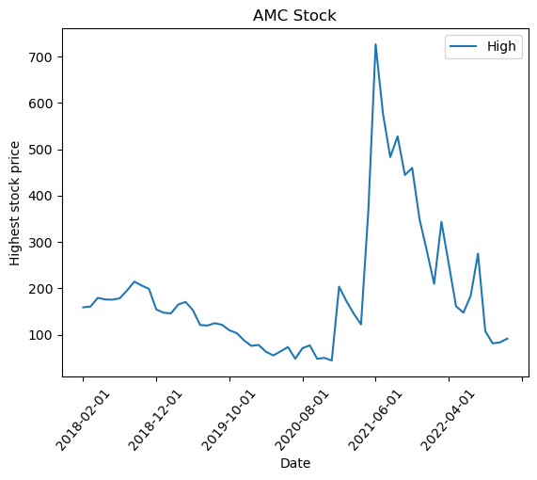

AMC Stock Prices 2018 to 2023

Slide 16
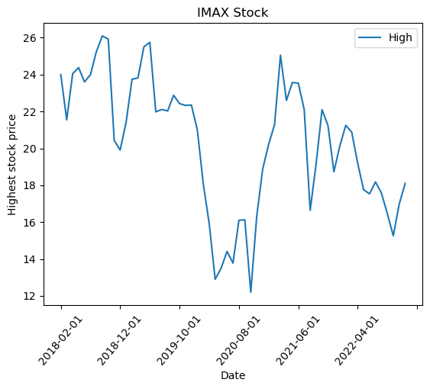

IMAX Stock Prices 2018 to 2023

Slide 17
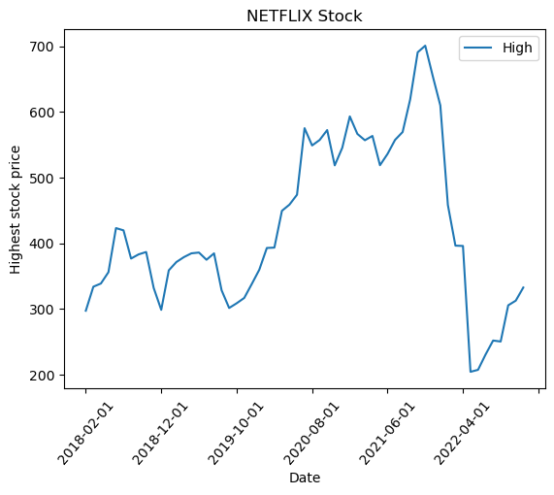

Netflix Stock Prices 2018 to 2023

Slide 18
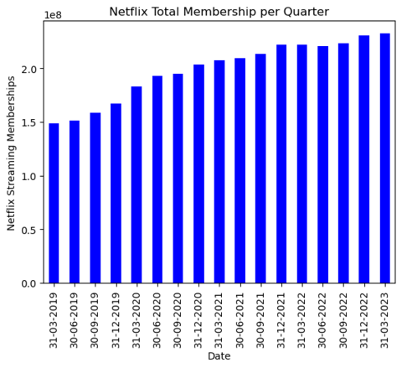

Netflix Memberships 2019 to 2023

Slide 19
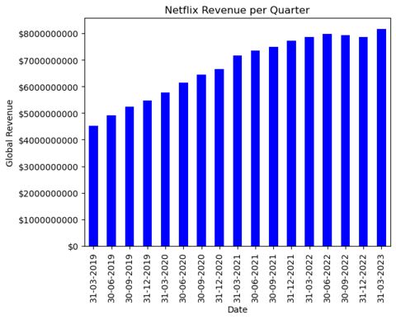

Netflix Revenue 2019 to 2023

Slide 20
Key takeaways
Revenue Losses during Pandemic
Streaming Service Explosion
Pandemic Numbers Rise, Movie Stock Prices Decline
Netflix Revenues Steadily Increase from 2019 to 2023
Revenues Continue to Underperform Pre-Pandemic Totals
The Movie Business is Cyclical

Slide 21
THANK YOU

